Slide 1
Deep Learning Recommender Architecture From a Master Thesis to Production

Slide 2
Agenda
Motivation.
Components.
Deep Learning Approach.
Deep Learning Recommender Architecture.
Final Notes.

Slide 3
Motivation
Germany's largest online vehicle marketplace
13.5M
Unique Users Per Month
43K
Dealers
2M
Items on page
800K
Changes to Items

Slide 4
Motivation
50M
Individual Searches
1M
Parking Events
80K
User Account Events
2M
User Preferences
40M
Item View Events
1 day
70K
Dealer Contacts
40K
Dealer Calls
100K
Logins/Logout Events
5K
Item Comparisons

Slide 5
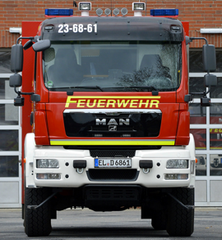
Motivation
User’s Car Preferences
Car Pool + Attributes (make, model, color, price, …)
Interactions of other users (views, parkings, contacts)
Flexible (cold-start, uncertainty, real-time, ...)

Slide 6
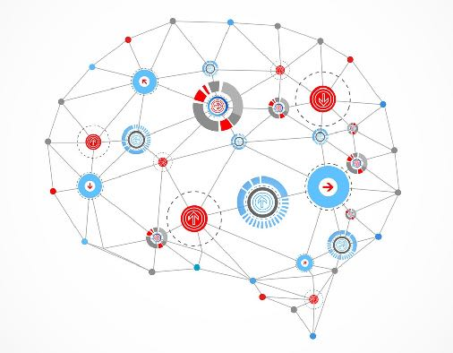
Motivation
Capture Nonlinear Relationships
Flexible and Holistic Approach
Deep Learning
Reduce Feature Engineering Effort
Improve Predictive Capability
Notes:
capture nonlinear relations: as our world is governed by nonlinearity and we as humans constantly fail to anticipate nonlinearity and traditional methods are rather linear, nonlinear methods like deep neural networks are more capable of solving real-world problems
holistic / flexible: extension / adaption of Rank/User/Item-Net possible, networks can be used separately while trained jointly (we train the overall network on the data and can then divide the overall network into the three subnets to perform different tasks like item embedding creation, user embedding creation and ranking within separated docker containers), holisticity by coming from raw data and ending up with a preference estimate and integrating well the tasks of candidate generation with ranking
less feature engineering: compared to traditional machine learning, we only need to format and normalize input data correctly instead of crafting manual features like price/mileage, as the ranknet already figures out what's necessary, nevertheless this comes at the cost of interpretability
improved quality: higher model complexity can better capture the underlying preferences which increases the relevance of recommendations compared to traditional matrix factorization based approaches towards recommender systems

Slide 7
Components – Item
Item Attributes
Condition: New
Make: VW
Model: Golf
Price: 32000
Mileage: 11000
Doors: 3
Seats: 5
More then 100 car attributes.
Currently only 20 attributes are used.
Items are updated constantly by dealers.
Ad Attributes

Slide 8
Components – User Preferences
User Preferences
Based on user interactions with the platform.
Updated just in time.
Based on Bayesian Statistics.
view
park
view
contact

Slide 9
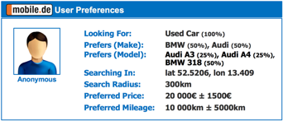
Deep Learning Approach
User Preferences Abstraction
Personalized
Ranking
1:
Black Box
2:
Mobile.de Listings
3:
4:
5:
Item Abstraction
„Which car would the user most likely consider next?“

Slide 10
Deep Learning Approach
Score (probability) between 0 and 1
Rank items embedding against user embedding
Vector of 77 Floats
Vector of 77 Floats
Mathematical abstraction of the User Preferences: User Embedding
Mathematical abstraction of the Item:
Item Embedding

Slide 11
Deep Learning Approach
User Preferences
User Embedding
Item 1: Embedding
Item 2: Embedding
Item 3: Embedding
[0.1, 0.4, 1.4, 3.4, 0.6, 4.5, 2.6]
[0.8, 0.3, 2.1, 4.1, 5.6, 0.8, 0.9]
[0.7, 0.3, 1.1, 4.1, 2.6, 5.8, 0.9]
[0.1, 0.9, 1.1, 4.1, 1.6, 5.8, 0.9]
Ranking User Embedding against Items Embedding
Scores ** the score is actually the probability of a user to interact with the item.
UserNet
ItemNet
- item 2: 0.82
- item 1: 0.64
- item 3: 0.59
RankNet

Slide 12
Deep Learning Architecture Python to Scala
Deep Learning Model Training

Slide 13
Deep Learning Architecture Python to Scala
Serving
Switch models on the flight – no down times.
Support model versioning – A/B testing.
C++ implementation.

Slide 14
Deep Learning Architecture Python to Scala
TensorFlow Python
export ML
TensorFlow ML Model - protbuf
build Docker image
update model
Docker Container
Scala Gateway
Grpc
TensorFlow Serving (C++)

Slide 15
Deep Learning Architecture Items Embedding
Kafka – items topic
UserNet
ItemNet
Docker Container
TF Serving ItemNet
Item Embedder
Grpc
RankNet
Items are updated constantly.
Items Embedding pre-calculation would not help.
Kafka would allow other teams to reuse items embedding for different use cases.
Kafka – items embedding topic

Slide 16
Deep Learning Architecture Candidate Items Selection
2M Items Embedding
rank user embedding against all items embedding
User Embedding
Pre filter step: candidate items selection
rank user embedding against candidate items embedding
Items Embedding
User Embedding
Approximately 200 – 300 candidates
Notes:
Ranking user Embedding against all items embedding => Would not scale !!!
Items must be first somehow filtered – candidates selection – and the ranking should be applied on the remaining results.
The candidate selection step (filter) should select approximately 200 – 300 items.

Slide 17
Deep Learning Architecture Candidate Items Selection
User Preferences
Filter items by Item attributes
Items Embedding Topic
Find all cars where: - color is RED or YELLOW.
- price range is: 20000 ± 1500 € - mileage range is: 10000 ± 5000 km - make is BMW or AUDI
ES Indexer
ES Query
Rank User Embedding against candidate Items Embedding --> Take top 10
Take Top 200
Notes:
- Items embedding are already include implicitly the Ad attributes, hence pre filtering first by ad attributes could lead to a not qualitative enough candidates.

Slide 18
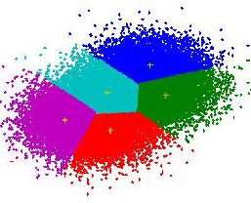
Deep Learning Architecture Candidate Items Selection
User Preferences
D2
find nearest items embedding clusters
D1
D3
Items Embedding Topic
D5
cluster items embedding
User Embedding
D4
Euclidean distance between User and Items Embedding
[0.1, 0.4, 1.4, 3.4, 0.6, 4.5, 2.6]
Item Embedding Cluster Centroid
ES Query with Rescore
ES Indexer
User Embedding
D
Distance
Rank User Embedding against candidate Items Embedding --> Take top 10
Take Top 200
Notes:
Euclidean distance in ES can be implemented via ES painless scripting language, however executing Euclidean distance calculation for all the documents in the index is very expensive, and pre filtering step must be done first.
Since items are constantly updated, their embedding might also change quite often, hence the clustering of items embedding must be re-calculated quite often in order to reflect the changes. One new cluster centroids have been calculated, The ES index must be updated for all items.

Slide 19
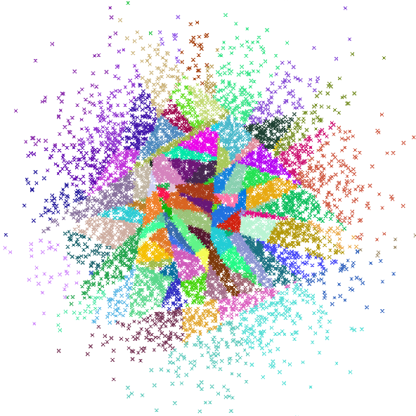
Deep Learning Architecture Candidate Items Selection
Annoy (Approximate Nearest Neighbors Oh Yeah ) - Spotify.
C++ library to search for points in space that are close to a given query point.
Scala and Python support.
In memory index file.
Euclidean ,Manhattan, cosine, or Hamming distance.
Works better for vectors with <100 dimensions.
Extremely fast !!!
Notes:
.

Slide 20
Deep Learning Architecture Candidate Items Selection
Kafka – items topic
UserNet
ItemNet
Docker Container
Item Embedder
Grpc
Tensor Serving ItemNet
Kafka – items embedding topic
RankNet
Hourly scheduled Jenkins job.
Consume all items embedding from Kafka topic.
Build new Annoy index file and push it to an Object Storage.
Hourly scheduled job
Consume all items from Kafka
Build Annoy
index
Annoy index file
Object Storage
Push

Slide 21
Deep Learning Architecture Recommendations Generator
Scala App Internals
User Preferences service
Get User Preferences
UserNet
ItemNet
User Embedding
Docker Container
Deep Learning Recommender – core App (Scala)
TF Serving userNet, rankNet
Find K nearest items (Annoy)
Grpc
RankNet
Rank user embedding against items embedding
Rank K items embedding against user embedding
Annoy index file
Recommendations
Take top N

Slide 22
Deep Learning Architecture Recommendations Generator
User Preferences service
Kafka – items topic
Docker Container
Docker Container
Item Embedder
Grpc
Tensor Serving ItemNet
Deep Learning Recommender – core App (Scala)
Grpc
Tensor Serving userNet, rankNet
Rank user embedding against items embedding
Kafka – items embedding topic
Annoy index file
Hourly scheduled job
Consume all items from Kafka
Build Annoy
index
Annoy index file
Recommendations
Pull
Push
Object Storage

Slide 23
Final Notes
Bring data scientists down to earth ☺
Take time to research and read.
Basic understanding of deep learning concepts is enough.
Scala Equivalent libs to Python – no code rewriting !
Creativity and out of the box thinking.

Slide 24
Questions ???

