Slide 1
Towards Flink 2.0 – Unifying the Batch and Streaming Stack
Stephan Ewen
Co-creator and PMC of Apache Flink
Ververica (formerly dataArtisans, now part of Alibaba Group)

Slide 2
Alternative Talk Titles
Batch is a special case of something
If all you have is a Squirrel, everything looks like a stream
Why is there still DataSet and DataStream? What's taking you folks so long?

Slide 3
This is talk is based on joint work with many members of the Apache Flink community
Xiaowei, Aljoscha, Timo, Dawid, Shaoxuan, Kurt, Guowei, Becket, Jincheng, Fabian, Till, Andrey, Gary, Chesnay, Piotr, Stefan, Zhijiang, Bowen, Haibo, etc.
And many others…
This is a snapshot of the state of design
discussion and work-in-progress. Some things may change as discussions evolve.

Slide 4
Apache Flink
Stateful Computations over Data Streams

Slide 5
Computing over Data Streams
Batch
Processing
Continuous
Processing
Data Pipelines
Streaming Analytics
Event-driven
Applications
Transactional
Applications
more lag time
more real time

Slide 6
Stream Processing based on
Apache Flink at Alibaba
Performance during "Singles Day"
machines
queries
throughput
latency
state size
Sub-Second
10K
10K
1.7B
100TB
events / sec
Notes:
Sub-second latency
Peak throughput: 1.7B Event/s
Largest Batch Job Input size: 100TB
Flink cluster size: 10K
Flink jobs: 10K

Slide 7
Some Apache Flink Users
Source: https://flink.apache.org/poweredby.html and https://sf-2019.flink-forward.org/speakers
Notes:
Sub-second latency
Peak throughput: 1.7B Event/s
Largest Batch Job Input size: 100TB
Flink cluster size: 10K
Flink jobs: 10K

Slide 8
The Relationship between Batch and Streaming

Slide 9
Everything is a Stream
Streams Of Records in a Log or MQ [e.g., Apache Kafka or AWS Kinesis …]

Slide 10
Everything is a Stream
Stream of Requests/Responses to/from Services
Service
GET /a/b
POST /b/c
PUT /e/f
200
404
200
200
403
DB
→ event sourcing architecture

Slide 11
Everything is a Stream
Stream of Rows in a Table or in Files
2016-3-1 12:00 am
2016-3-1 1:00 am
2016-3-1 2:00 am
…
2016-3-11 10:00pm
2016-3-11 11:00pm
2016-3-12 12:00am
2016-3-12 1:00am
2016-3-12 2:00am
2016-3-12 3:00am

Slide 12
A batch is a Bounded Stream
Stream of Rows in a Table or in Files
2016-3-1 12:00 am
2016-3-1 1:00 am
2016-3-1 2:00 am
…
2016-3-11 10:00pm
2016-3-11 11:00pm
2016-3-12 12:00am
2016-3-12 1:00am
2016-3-12 2:00am
2016-3-12 3:00am
a batch

Slide 13
Batch Processing is a special case of Stream Processing
A batch is just a bounded stream.
That is about 60% of the truth…

Slide 14
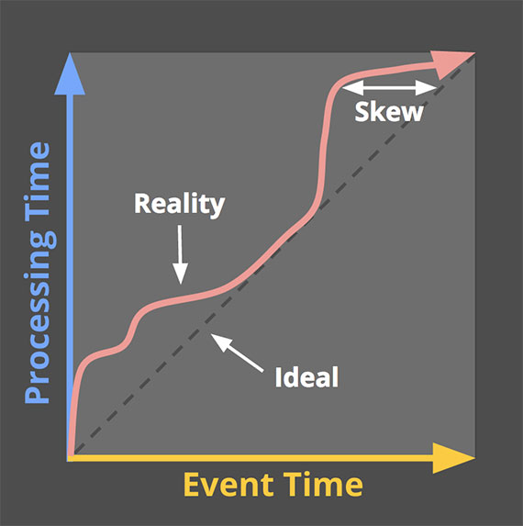
The remaining 40% of the truth
… never seen this in Batch Processing, though.
The (Event-time Low) Watermark

Slide 15
The remaining 40% of the truth
Continuous
Streaming
Batch
Processing
Data is incomplete
Data is as complete as it gets within the job
Latency SLAs
Completeness and Latency is a tradeoff
No Low Latency SLAs

Slide 16
Stream Real-time Processing
unprocessed
watermark
older
more recent
Notes:
Time in data stream must be quasi monotonous to produce time progress (watermarks)
Always have close-to-latest incremental results
Resource requirements change over time
Recovery must catch up very fast

Slide 17
Stream Re-Processing
unprocessed
watermark
older
more recent
Notes:
Time in data stream must be quasi monotonous to produce time progress (watermarks)
Always have close-to-latest incremental results
Resource requirements change over time
Recovery must catch up very fast

Slide 18
Batch Processing
unprocessed
watermark
older
more recent
Notes:
Order of time in data does not matter (parallel unordered reads)
Bulk operations (2 phase hash/sort)
Longer time for recovery (no low latency SLA)
Resource requirements change fast throughout the execution of a single job

Slide 19
Batch vs. Stream Processing
Continuous
Streaming
Batch
Processing
Watermarks to model Completeness/Latency tradeoff
No Watermarks
Incremental results & Proc.-Time Timers
Results at end-of- program only
In-receive-order ingestion with low parallelism
Massively parallel out-of-order ingestion

Slide 20
The remainder of this talk
What does that mean for
(1) A unified Batch/Streaming
Data Processing Runtime
(2) Unified Batch- and Streaming APIs

Slide 21
Stream- and Batch- Processing in the Runtime

Slide 22
Exploiting the Batch Special Case
activates additional
optimizer choices
Planner/Optimizer
if (bounded && non-incremental)
Continuous Operators
Additional Bounded Operators
Streaming
Scheduler Rules
Additional Scheduling Strategies
Core operators,
cover all cases
Optimized operators
for subset of cases

Slide 23
Scheduling Strategies
Build pipelined regions
Incremental results: everything pipelines
Non-incremental results: break pipelines once in a while
Recovery: Restart the pipelined region from latest checkpoint (or beginning)
replay input since checkpoint or beginning
✘
✘

Slide 24
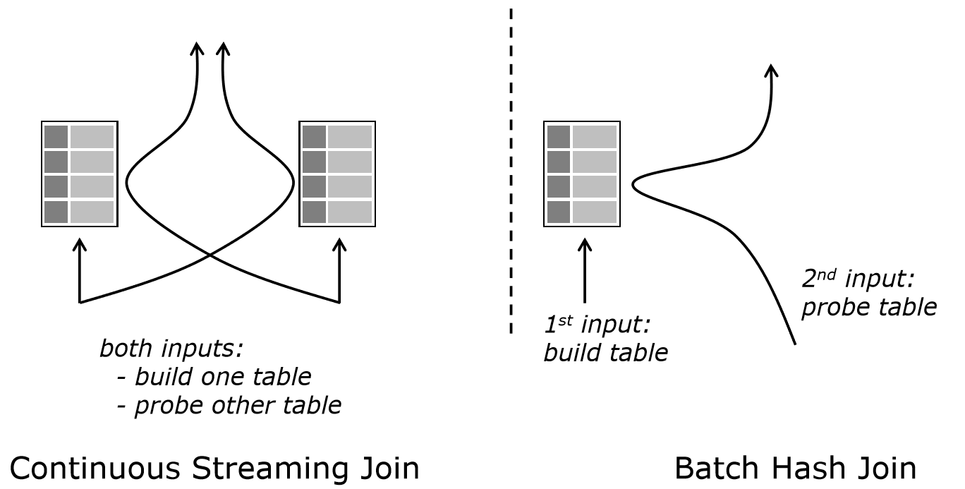
Streaming versus Batch Join

Slide 25
Streaming versus Batch Join
2x RocksDB
LSM-Trees
1x Hybrid Hash Join
only on bounded data
batch results
no checkpoints
bounded/ unbounded
incremental results
more general
order-of-magnitude faster

Slide 26
Streaming versus Batch Join
push-based
(latency/checkpoints)
pull-based
(data flow control)
more general
order-of-magnitude faster

Slide 27
Push-based and Pull-based Operators
pull()
pull()
accept data from any input immediately (like actor messages)
pull data from one input at a time
(like reading streams)
minimize latency, supports checkpoint alignment
control over data flow,
high-latency, breaks checkpoints

Slide 28
Selectable Push-based Operators
similar to non-blocking-I/O model
Java NIO, Linux Epoll, or Select
select()
select()
subscribe to inputs (select)
and receive pushed events
➔ Operators control data flow by selecting active data paths ➔ Among active data paths, fully asynchronous data flow driven by network, data sources (and timers)

Slide 29
Selectable Push-based Operators
similar to non-blocking-I/O model
Java NIO, Linux Epoll, or Select
subscribe to inputs (select)
and receive pushed events
➔ Input selection affects network channel credit assignment. ➔ Possible to process checkpoints through deselected channels (not yet implemented)

Slide 30
Flink 1.9 Table API and Merging Blink
Table API / SQL
Flink Query Processor
Blink Query Processor
batch env.
stream env.
batch & stream
DataSet
StreamTransformation
Driver (Pull)
StreamOperator (selectable push)
Flink Task Runtime

Slide 31
Stream- and Batch- Processing in the APIs

Slide 32
Flink's future API Stack
Still possible to mix and match within a program
DataSet
(deprecated)
DataStream
Table / SQL
Stream Operator & DAG API
Runtime

Slide 33
APIs for Analytical Processing and Applications
DataStream API
SQL / Table API
Applications
(physical)
Analytical Processing
(declarative)
Types are Java / Scala classes
Logical Schema
Transformation Functions
Declarative Language (SQL, Table DSL)
Explicit State and Time
Automatic Optimization

Slide 34
SQL / Table API – Batch style (fix data set as input)
SQL Query
Batch Query Execution
SELECT
room,
TUMBLE_END(rowtime, INTERVAL '1' HOUR),
AVG(temperature)
FROM
sensors
GROUP BY
TUMBLE(rowtime, INTERVAL '1' HOUR), room

Slide 35
SQL / Table API – Streaming Data Case
update database
with changes
SQL Query
Interpret Stream as Table
Incremental Query Execution
output result changes as stream
SELECT
room,
TUMBLE_END(rowtime, INTERVAL '1' HOUR),
AVG(temperature)
FROM
sensors
GROUP BY
TUMBLE(rowtime, INTERVAL '1' HOUR), room

Slide 36
More Details also
Beam Summit Europe – Thursday June 19th
One SQL to Rule Them All – a Syntactically Idiomatic Approach to Management of Streams and Tables
Fabian Hüske, Tyler Akidau

Slide 37
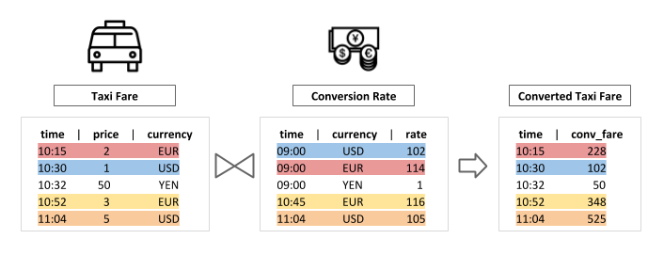
SQL / Table API – Temporal Joins Example
SELECT tf.time
tf.price * rh.rate as conv_fare
FROM taxiFare AS tf
LATERAL TABLE (Rates(tf.time)) AS rh
WHERE tf.currency = rh.currency;

Slide 38
SQL / Table API – Event Pattern Matching Example

Slide 39
DataStream API
DataStream is already supporting Bounded and Unbounded Streams
Introduce BoundedDataStream and non-incremental mode to exploit optimizations for bounded data
Watermarks "jump" from -∞ to +∞ at end of program
Processing time timers deactivated or deferred (end of key)
Cannot offer this mode before runtime supports batch-style execution.
This is not a final design, it is
an intermediate state of
still informal design discussions

Slide 40
DataStream Sources - Flink Improvement Proposal (FLIP) - 27
Ongoing work to unify the data source API between batch and streaming
Current draft is based on input splits and non-blocking (async) readers
Synchronous implementations for common source threading models
Split/partition processing in-/out-of -order
Further goals
common checkpointing, per-partition watermarks, event-time idleness, event-time alignment
https://cwiki.apache.org/confluence/display/ FLINK/FLIP-27%3A+Refactor+Source+Interface

Slide 41
What else is the Flink Community currently working on?

Slide 42
Hive support
Cross-Batch-Streaming
Machine Learning
Python Table API
Querying state and snapshots
More powerful incremental streaming SQL runtime
Atomic stop-with-savepoint
Interactive multi-job programs
a big documentation overhaul
…and lot's more

Slide 43
Thank you!
If you liked this, engage with the Apache Flink® community
Try Flink and help us improve it
Contribute docs, code, tutorials
Share your use cases and ideas
Join a Flink Meetup
Come to Flink Forward (https://www.flink-forward.org/)
@StephanEwen
@ApacheFlink
@VervericaData
https://flink.apache.org/

