Slide 1
Meeting complex data load and data preparation challenges for search applications with Apache NiFi
Johannes Peter
MediaMarktSaturn Retail Group
Product Owner / Architect for Search
Notes:
Before – external consultant in different companies for search and NLP projects in the context of ecommerce and enterprise search

Slide 2
Challenges for search applications
People
E-commerce
Enterprise search
Scaling
Access rights
Campaigns
Performance
Relevancy
Data extraction
Data transformation
Data enrichment
Notes:
Hiring, coordinating, educating, motivating …
Several challenges that have to be done before the search engine sees the data
Data preprocessing
In all search projects where I was involved and which aimed to develop a search solution, the discussions at the beginning actually were not really about search but rather about what has to be done before the data can be pushed into the search engine

Slide 3
Data
expected
actual
Notes:
In many projects, data is expected to be easily retrievable, well-structured, reliable, valid, complete, …
But in the end, a lot of time is required to tame it and a lot of time is spent until the data is ready to be pushed into the search engine

Slide 4
Typical data preprocessing issues
Different source systems
Enrichments
Transformations, standardizations
Bottlenecks, scaling
...
Notes:
Different source systems with different characteristics, different security mechanisms
Lookups: E. g. Product data shall e enriched by price data
Data standardizations: E. g. release data (available / deliverable, ordered in advance
Bottlenecks: expensive operation
Scaling: very frequent updates, big volumes
for search these issues are particularly challenging as
tools specialized on such operations frequently only capable processing structured data
search solutions usually have to handle semi-structured or unstructured data
NiFi is well suited for search
Provides solutions for all these issues
Principally is able to handle all kinds of data

Slide 5
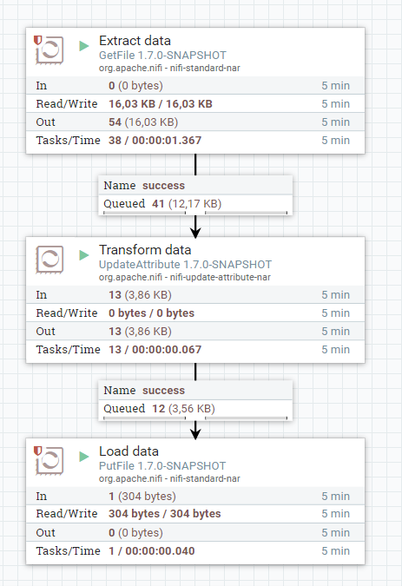
Essentials of NiFi
FlowFile
metadata
content
Notes:
Principally: Pull data, transform it and push it
Data in NiFi is contained in FlowFiles
metadata (key-value pairs) and some content (smaller or bigger pieces of data)
The metadata and the content can be transformed in processors. Each processor is intended to fulfil a designated task
E. g. Extract data from a source system like a relational database, hadoop, or a no-sql store
Other processors are designated to transform or to enrich data, e. g. to change the format and the structure of the data, or lookups basing on flowfile content
And finally, there are various processors to push data into target application (including Solr or Elasticsearch)
Processors can be combined via queues to dataflows; flowfiles are created or changed by a processor and then put into a queue where they are waiting until they are processed by the next processor

Slide 6
Records
Processor
Reader
Writer
xml
xml
json
serialize
write
json
text
avro
…
…
Notes:
NiFi has various processors to interact with other systems, you frequently have to deal with different formats, e. g. xml, csv, json or simply text.
If the data is exchanged between systems, transformations of the data are frequently required
Various different processors were needed in order to cover all possible data transformations e. g. for transforming json to xml, csv to avro, json to other json
All these formats have in common that they usually contain several individable entrys
In order to avoid this, NiFi provides an abstraction for data
so-called record-reader and record-writer.
The reader reads xml or json data and serializes it,
whereas the record writer writes the serialized data to a certain format
Functionalities of processors

Slide 7
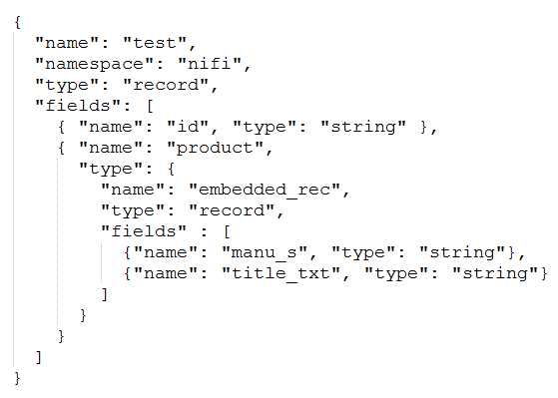
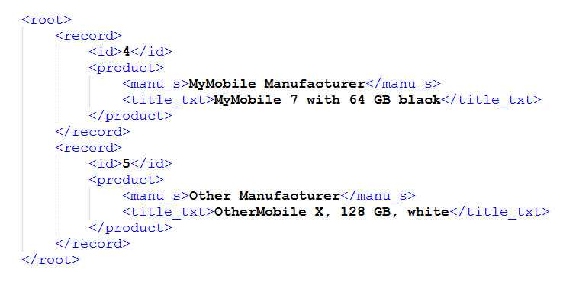
Schema (xml)
FlowFile
Notes:
All the user has to do to achive this is to define an avro schema

Slide 8
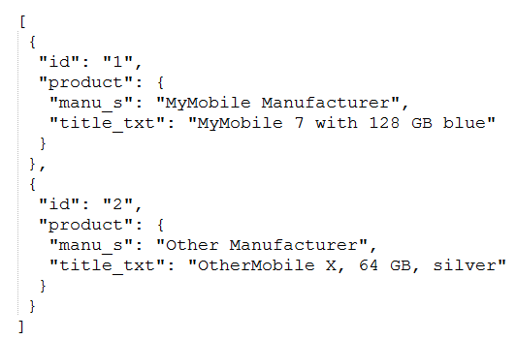
Schema (json)
FlowFile

Slide 9
Operations on serialized records
Transformations
Lookups in source systems
SQL
Validations
Merge, partition, split
Notes:
A lot of ootb functionalities
Frameworks for customizations

Slide 10
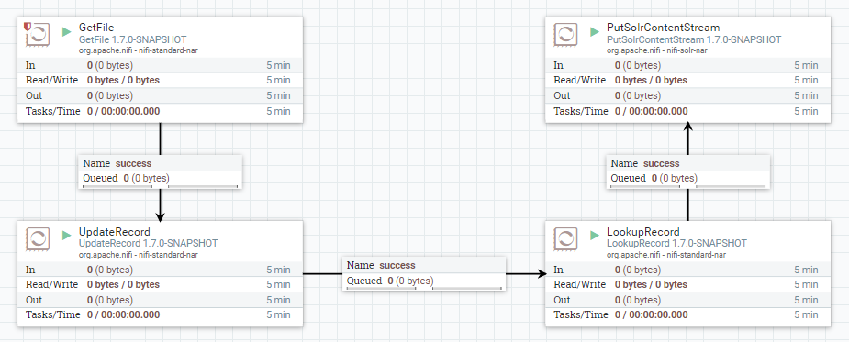
Show-case

Slide 11
Conclusion
Dataflows can be quickly created
Customizable
Scalable
Data provenance
Well suited for search
Notes:
Dataflows: configured via ui
Highly customizable: NiFi includes well-defined APIs to integrate self-developed processors
Scalable: Get rid of bottlenecks by allowing NiFi to run certain processors with multiple threads
Data provenance: flowfiles are tracked – there are very good opportunities to reconstruct the life of flowfiles
Well suited for search: Interaction with Solr or Elasticsearch is supported by various processors

Slide 12
Thank you!
peterj@mediamarktsaturn.com

